Slide 1
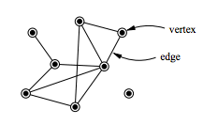
Definition of a Graph
Definition:
A graph G = (V, E) consists of a nonempty set V of vertices (or nodes) and a set E of edges. Each edge has either one or two vertices associated with it, called its endpoints. An edge is said to connect its endpoints.
Notes:
In this class, we talk about mathematical properties of graphs.
In Algorithms, we talk about how graphs are represented in a computer (data structures used), and study some important, fundamental algorithms for processing graphs.

Slide 2
Definition of a Graph
Definition:
A graph G = (V, E) consists of a nonempty set V of vertices (or nodes) and a set E of edges. Each edge has either one or two vertices associated with it, called its endpoints. An edge is said to connect its endpoints.
Notes:
In this class, we talk about mathematical properties of graphs.
In Algorithms, we talk about how graphs are represented in a computer (data structures used), and study some important, fundamental algorithms for processing graphs.

Slide 3
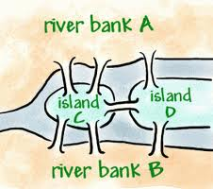
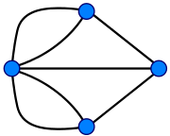
Königsberg Bridge Problem
Source: http://mkcohen.com/saturday-puzzle-7-the-konigsberg-bridge-problem
Notes:
The Seven Bridges of Königsberg is a historically notable problem in mathematics. Its negative resolution by Leonhard Euler in 1736 laid the foundations of graph theory and prefigured the idea of topology.^{[1]}
The city of Königsberg in Prussia (now Kaliningrad, Russia) was set on both sides of the Pregel River, and included two large islands which were connected to each other and the mainland by seven bridges. The problem was to devise a walk through the city that would cross each bridge once and only once, with the provisos that: the islands could only be reached by the bridges and every bridge once accessed must be crossed to its other end. The starting and ending points of the walk need not be the same.

Slide 4
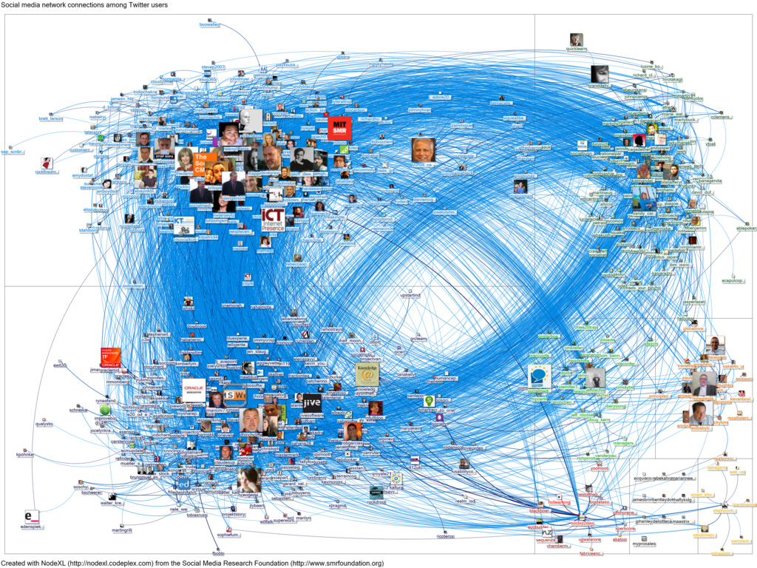
http://www.wikihow.com/images/3/30/20120212-NodeXL-Twitter-socbiz-network-graph.jpg

Slide 5
Undirected Graph Example
Detroit
New York
San Francisco
Chicago
Denver
Washington
Los Angeles

Slide 6
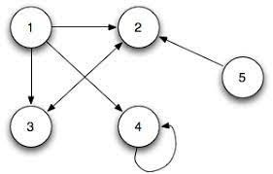


Directed Graph
The edges are ordered pairs of (not necessarily distinct) vertices.
Detroit
Chicago
New York
San Francisco
Denver
Washington
Los Angeles
Loops or (self edges) are not allowed in simple graphs

Slide 7
Directed Graph
The edges are ordered pairs of (not necessarily distinct) vertices.
Detroit
Chicago
New York
San Francisco
Denver
Washington
Los Angeles
Directed graphs (digraphs) have directed edges.
In directed graphs, for each edge x → y, x is the predecessor of y, and y is the successor of x.

Slide 8
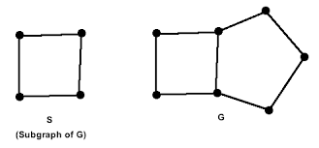
Subgraph
A subgraph is a graph whose vertices and edges are subsets of another graph
Notes:
In this class, we talk about mathematical properties of graphs.
In Algorithms, we talk about how graphs are represented in a computer (data structures used), and study some important, fundamental algorithms for processing graphs.

Slide 9
Subgraph
A subgraph of a graph G = (V, E) is a graph H = (W, F) where W ⊆ V and F ⊆ E.
K
C
Is C a subgraph of K?
Notes:
Yes

Slide 10
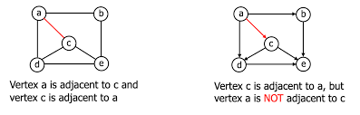
Adjacent Vertices
Two vertices, u and v in an undirected graph G are called adjacent (or neighbors) in G, if (u,v) is an edge of G.

Slide 11
Graph Models
Graphs and graph theory can be used to mode
Computer networks
Social networks
Communication networks
Software design
Etc...

Slide 12
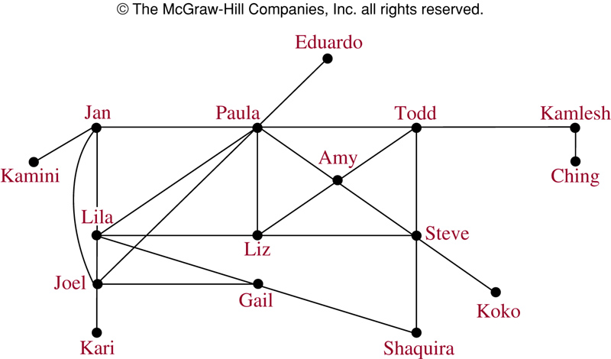
Acquaintanceship Graph
Notes:
Graphs like this are used in visual analytics; tracking down criminal / terrorist organizations, etc.
Who knows the most people in this graph?
Could this graph represent everyone in the world?
How many vertices? 6.2 billion
How many edges? > 1 trillion

Slide 13
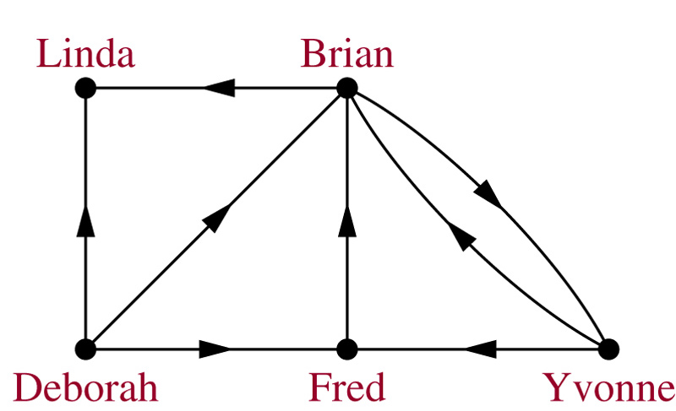
Influence Graph
Notes:
Who is the most influential person in this graph?
Deborah

Slide 14
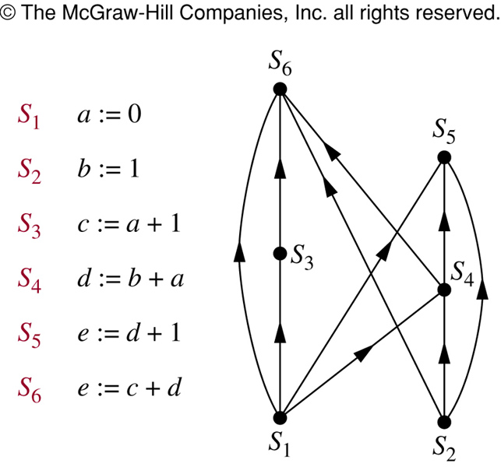
Precedence Graphs
In concurrent processing, some statements must be executed before other statements. A precedence graph represents these relationships.
Notes:
Used for low-level compiler optimizations: pipelining, concurrent instruction scheduling.

Slide 15
Collaboration Graph
The Hollywood graph models the collaboration of actors in films:
Vertices represent actors
Edges represent the fact that the two actors have worked together on some movie
As of October 2007, this graph had 893,283 vertices, and over 20 million edges.

Slide 16
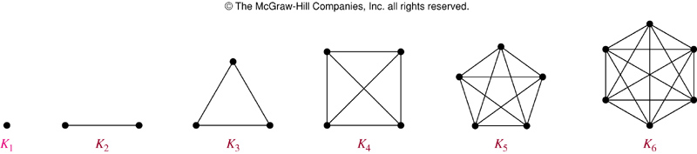
Complete Graph
The complete graph on n vertices (K_{n}) is the simple graph that contains exactly one edge between each pair of distinct vertices.
The figures above represent the complete graphs, K_{n}, for n = 1, 2, 3, 4, 5, and 6.

Slide 17
Cycle
The cycle C_{n} (n ≥ 3), is a subgraph consisting of n vertices v₁, v₂, …, v_{n} and edges {v₁,v₂}, {v₂,v₃}, …, {v_{n-1},v_{n}}, and {v_{n},v₁}.
Cycles:
C₃
C₄
C₅
C₆

Slide 18
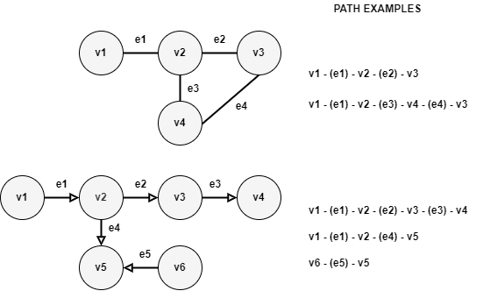
Path
A path between two vertices is a sequence of edges that begins at one vertex and ends at the other vertex.
A path may pass through the same vertex more than once, but a simple path may not.

Slide 19
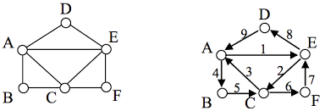
Euler Circuit
An Euler Path is a path that goes through every edge of a graph exactly once. An Euler Circuit is an Euler Path that begins and ends at the same vertex.

Slide 20
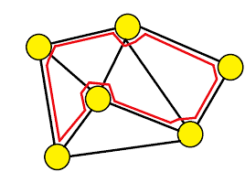
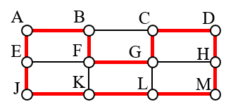
Hamiltonian Circuit
A Hamiltonian path is a path in an undirected or directed graph that visits each vertex exactly once. A Hamiltonian cycle (or Hamiltonian circuit) is a cycle that visits each vertex exactly once

Slide 21
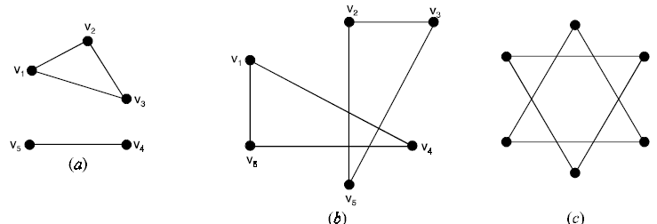
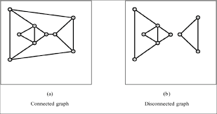
Connected
A graph is connected if each pair of distinct vertices has a path between them.
If a path does not exist between each pair of distinct vertices, it is disconnected.
Notes:
all disconnected in 2nd pic

Slide 22
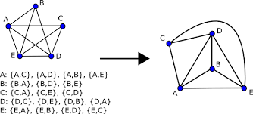
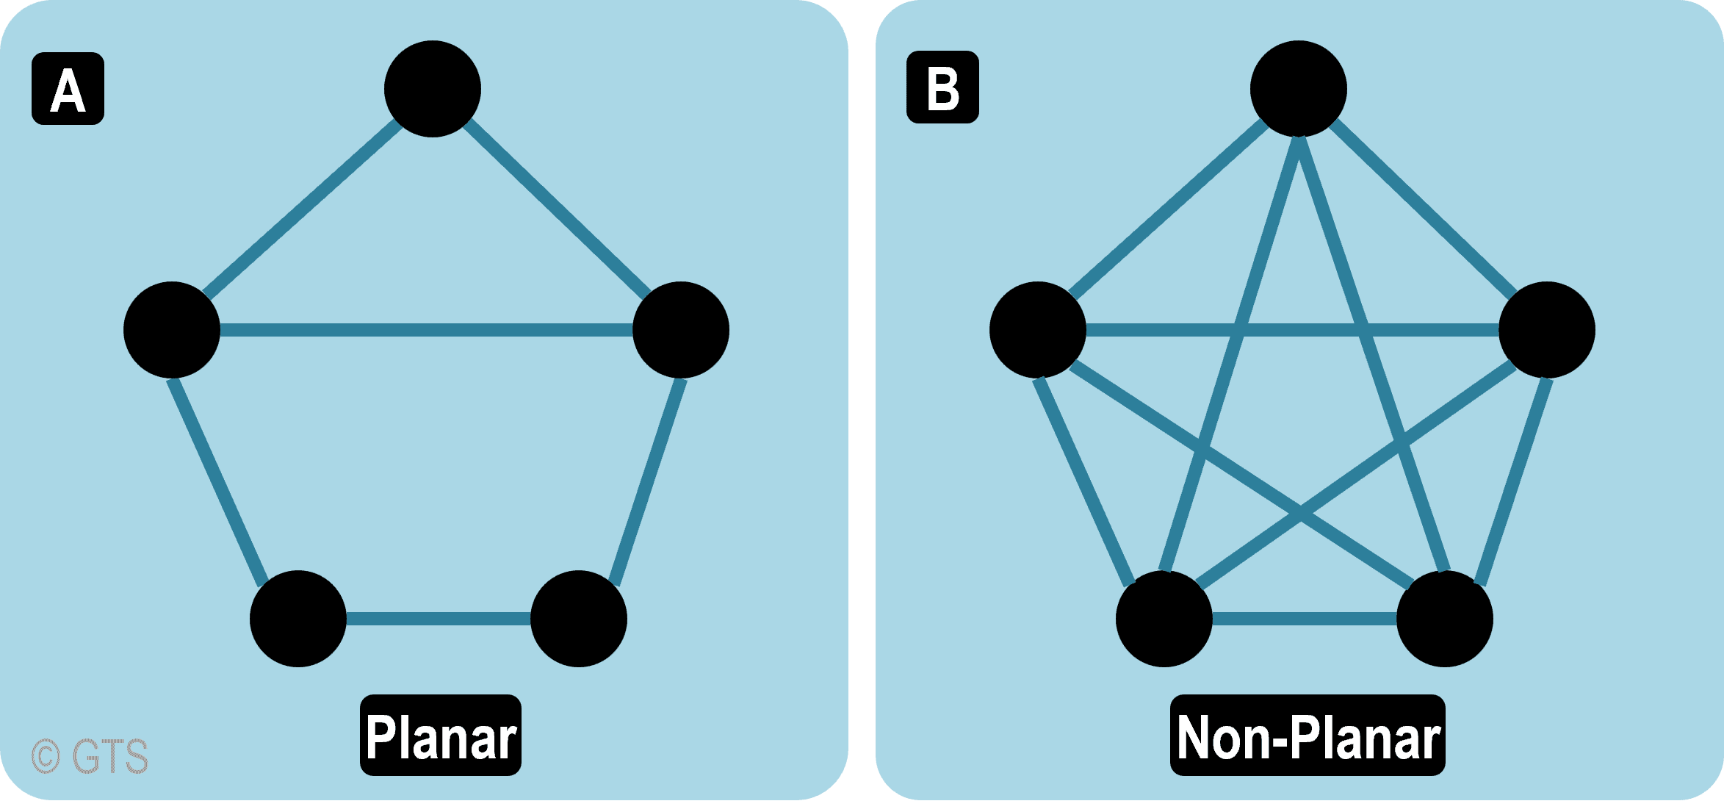
Planar Graph
A graph is said to be planar if it can be drawn in a plane so that no edge cross

Slide 23
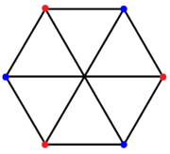
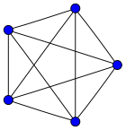

Planar Testing
Kuratowski’s Theorem. A graph is planar if and only if it does not contain a subgraph that is a subdivision of $K_{5}$ or $K_{3,3}$

Slide 24
Graph Representations
Adjacency List
Adjacency Matrix
Incidence Matrix

Slide 25
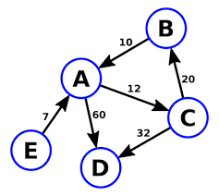
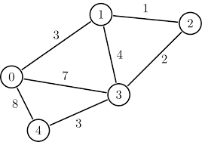
Weighted vs. Unweighted
When edges are labeled with a numeric value, the graph is referred to as a weighted graph.

Slide 26
Graph ADT
We can treat graphs as abstract data types.
A Graph ADT has the following operations:
Create an empty graph.
Determine whether a graph is empty
Determine the number of vertices in a graph.
Determine the number of edges in a graph.
Determine whether an edge exists between two given vertices.
For weighted graphs, return weight value.
Insert a vertex in a graph whose vertices have distinct search keys that differ from the new vertex’s search key.
Insert an edge between two given vertices in a graph.
Delete a particular vertex from a graph and any edges between the vertex and other vertices.
Delete the edge between two given vertices in a graph.
Retrieve from a graph the vertex that contains a given search key

Slide 27
Adjacency List
Let G = (V, E) a simple graph with n vertices. An array of linked lists is used. Size of the array is equal to number of vertices. An entry array[i] represents the linked list of vertices adjacent to the i^{th} vertex.

Slide 28
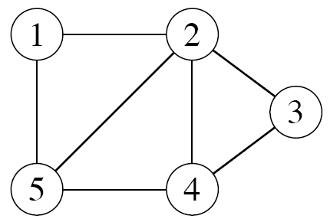
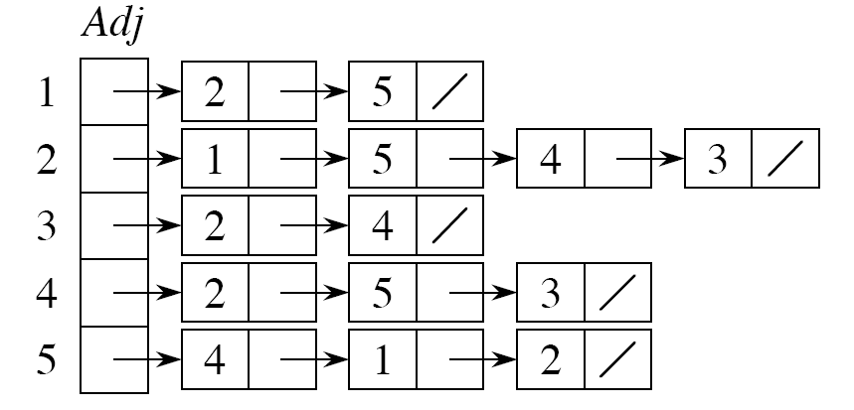
Adjacency List
How would we implement an isEdge(u,v) method that checks for an edge between u and v?

Slide 29
Adjacency Matrix
A simple graph G = (V, E) with n vertices can be represented by its adjacency matrix, A, where the entry a_{ij} in row i and column j is:

Slide 30
Adjacency Matrix Example
To
a b c d e f
c
From
a
b
c
d
e
f
0 1 0 0 1 1
1 0 1 0 0 1
0 1 0 1 0 1
0 0 1 0 1 1
1 0 0 1 0 1
1 1 1 1 1 0
b
d
f
a
e
W₅
How would we implement an isEdge(u,v) method that checks for an edge between u and v?
{v₁,v₂}
row column

Slide 31
Incidence Matrix
Let G = (V, E) be an undirected graph. Suppose v₁,v₂,v₃,…,v_{n} are the vertices and e₁,e₂,e₃,…,e_{m} are the edges of G. The incidence matrix w.r.t. this ordering of V and E is the n × m matrix M = [m_{ij}], where

Slide 32
Incidence Matrix Example
Represent the graph shown with an incidence matrix.
e₁ e₂ e₃ e₄ e₅ e₆
edges
v₁ v₂ v₃
e₆
v₁
v₂
v₃
v₄
v₅
1 1 0 0 0 0
0 0 1 1 0 1
0 0 0 0 1 1
1 0 1 0 0 0
0 1 0 1 1 0
e₃
e₁
e₄
e₅
e₂
v₄ v₅
vertices

Slide 33
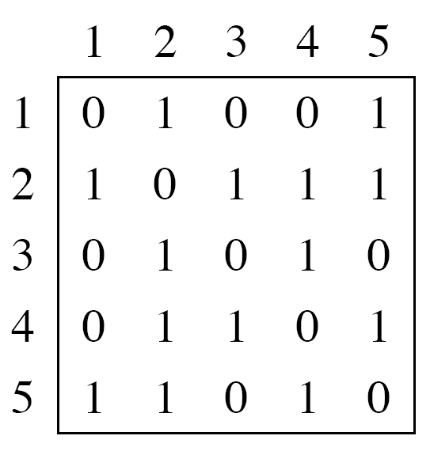
Adjacency List and Matrix: Undirected Graph

Slide 34
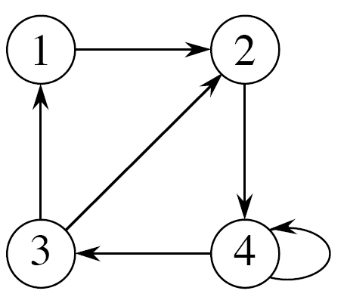
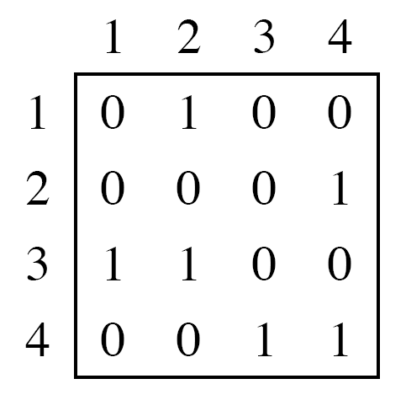
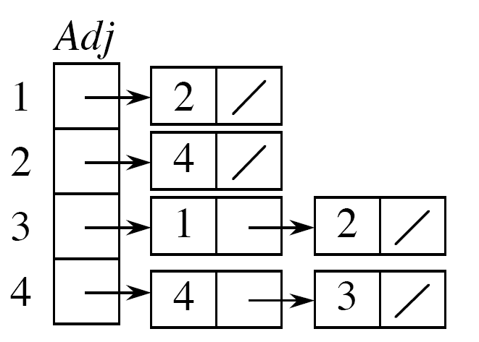
Adjacency List and Matrix: Directed Graph
terminal
initial

Slide 35
Example
u₁
u₂
v₁
v₂
u₃
u₄
v₃
v₄
G
H
Are G and H isomorphic (i.e. represent the same information)?

Slide 36
Example
u₁
u₂
v₁
v₂
u₃
u₄
v₃
v₄
G
H
Yes. A possible mapping is:
f(u₁) = v₁, f(u₂) = v₄, f(u₃) = v₃, f(u₄) = v₂

Slide 37
Graph Traversal Algorithms
Many problems require processing all graph vertices (and edges) in systematic fashion
Graph traversal algorithms:
Depth-first search (DFS)
Breadth-first search (BFS)

Slide 38
Depth-First Search (DFS)
Visits graph’s vertices by always moving away from last visited vertex to unvisited one, backtracks if no adjacent unvisited vertex is available.
Uses a stack
a vertex is pushed onto the stack when it’s reached for the first time
a vertex is popped off the stack when it becomes a dead end, i.e., when there is no adjacent unvisited vertex
“Redraws” graph in tree-like fashion (with tree edges and back edges for undirected graph)

Slide 39
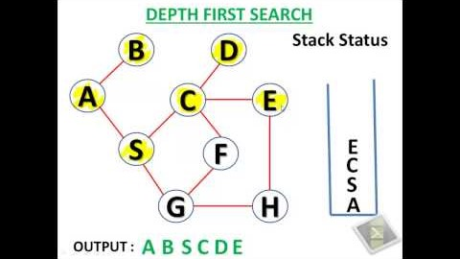
Example: DFS traversal of undirected graph
Notes:
Start at 30 sec
1.5x speed

Slide 40
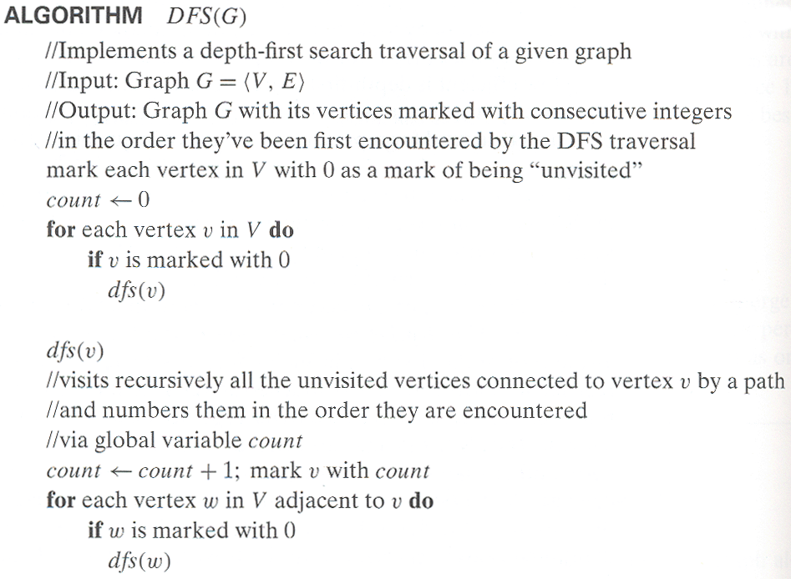
Pseudocode of DFS

Slide 41
Example: DFS traversal of undirected graph
a
b
c
d
e
f
g
h
DFS traversal stack:
DFS tree:
a
b
c
d
e
f
g
h
Notes:
Traversal using alphabetical order of vertices. Work through this example in detail,
showing the traversal by highlighting edges on the graph and showing how the stack
evolves:
8 h 3
7 d 4 stack shown growing upwards
4 e 1 6 c 5 number on left is order that vertex was pushed onto stack
3 f 2 5 g 6 number on right is order that vertex was popped from stack
2 b 7 overlap is because after e, f are popped off stack, g and c
1 a 8 are pushed onto stack in their former locations.
order pushed onto stack: a b f e g c d h
order popped from stack: e f h d c g b a
* show dfs tree as it gets constructed, back edges

Slide 42
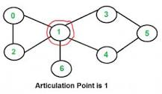
Notes on DFS
DFS can be implemented with graphs represented as:
adjacency matrices: Θ(|V|²)
adjacency lists: Θ(|V|+|E|)
Yields two distinct ordering of vertices:
order in which vertices are first encountered (pushed onto stack)
order in which vertices become dead-ends (popped off stack)
Applications:
checking connectivity, finding connected components
finding articulation points and biconnected components
searching state-space of problems for solution (AI)
Notes:
A vertex in an undirected connected graph is an articulation point (or cut vertex) if removing it (and edges through it) disconnects the graph.
Iterate over all the vertices and for every vertex do the following:
Remove v from graph
See if the graph remains connected (We can either use BFS or DFS)
Add v back to the graph
A biconnected component is a maximal biconnected subgraph. A biconnected graph is a connected and "nonseparable" graph, meaning that if any one vertex were to be removed, the graph will remain connected.
In above graph, following are the biconnected components:
4–2 3–4 3–1 2–3 1–2
8–9
8–5 7–8 5–7
6–0 5–6 1–5 0–1
10–11

Slide 43
Breadth-first search (BFS)
Visits graph vertices by moving across to all the neighbors of last visited vertex
Instead of a stack, BFS uses a queue
Similar to level-by-level tree traversal
“Redraws” graph in tree-like fashion (with tree edges and cross edges for undirected graph)

Slide 44
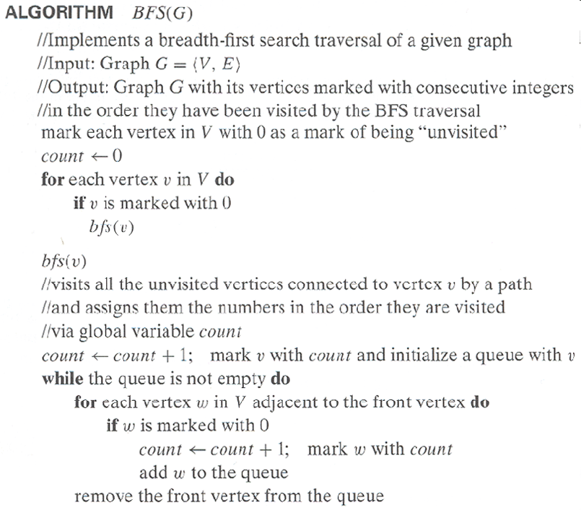
Pseudocode of BFS

Slide 45
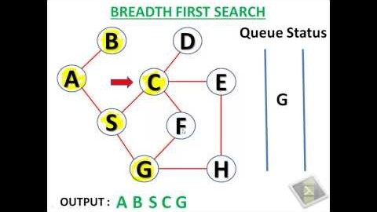
Example: BFS traversal of undirected graph
Notes:
Start at 40 sec
2x speed

Slide 46
Example of BFS traversal of undirected graph
a
b
c
d
e
f
g
h
BFS traversal queue:
BFS Tree:
a
b
c
d
e
f
g
h

Slide 47
Notes on BFS
BFS has same efficiency as DFS and can be implemented with graphs represented as:
adjacency matrices: Θ(|V|²)
adjacency lists: Θ(|V|+|E|)
Yields single ordering of vertices (order added/deleted from queue is the same)
Applications: same as DFS, but can also find paths from a vertex to all other vertices with the smallest number of edges

Slide 48
Minimum Spanning Tree (MST)
Spanning tree of a connected graph G: a connected acyclic subgraph of G that includes all of G’s vertices. This means the subgraph has no cycles.
Minimum spanning tree of a weighted, connected graph G: a spanning tree of G of minimum total weight (computed by sum of edge weights)
Example: Graph Minimum Spanning Tree
6
c
c
a
a
4
1
1
2
2
d
d
b
3
b
3

Slide 49
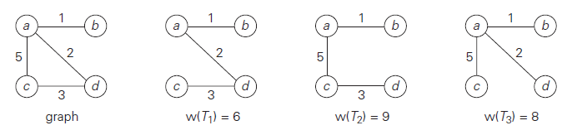
MST EXAMPLE

Slide 50
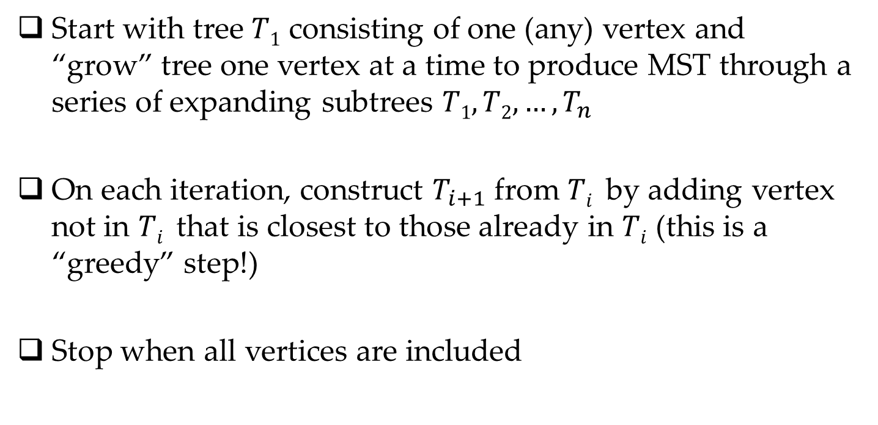
Prim’s MST algorithm
Start with tree $T1$ consisting of one (any) vertex and “grow” tree one vertex at a time to produce MST through a series of expanding subtrees $T1, T2, …, T_{n}$
On each iteration, construct $T_{i+1}$ from $Ti$ by adding vertex not in $Ti$ that is closest to those already in $Ti$ (this is a “greedy” step!)
Stop when all vertices are included

Slide 51
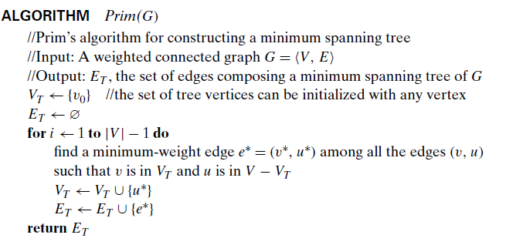
PRIM ALGORITHM
4
c
a
1
6
2
d
b
3

Slide 52
Example PRIM ALGORITHM
4
c
c
a
a
1
1
6
2
2
d
d
b
3
b
3

Slide 53
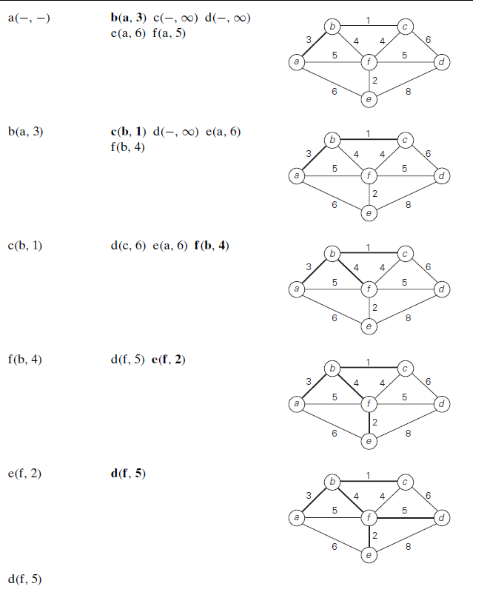
Example

Slide 54
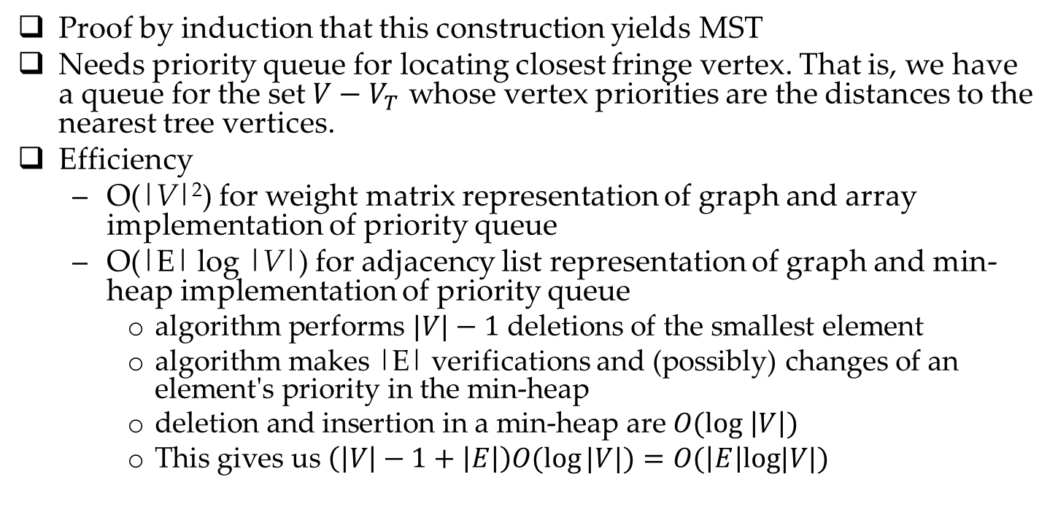
Notes about Prim’s algorithm
Proof by induction that this construction yields MST
Needs priority queue for locating closest fringe vertex. That is, we have a queue for the set $V−V_{T}$ whose vertex priorities are the distances to the nearest tree vertices.
Efficiency
O(|V|²) for weight matrix representation of graph and array implementation of priority queue
O(|E| log |V|) for adjacency list representation of graph and min-heap implementation of priority queue
algorithm performs $|V|−1$ deletions of the smallest element
algorithm makes |E| verifications and (possibly) changes of an element's priority in the min-heap
deletion and insertion in a min-heap are $O(log \left|V\right|)$
This gives us $\left(\left|V\right|−1+\left|E\right|\right)O(\log{|V|)=O(\left|E\right|log|V|)}$

Slide 55
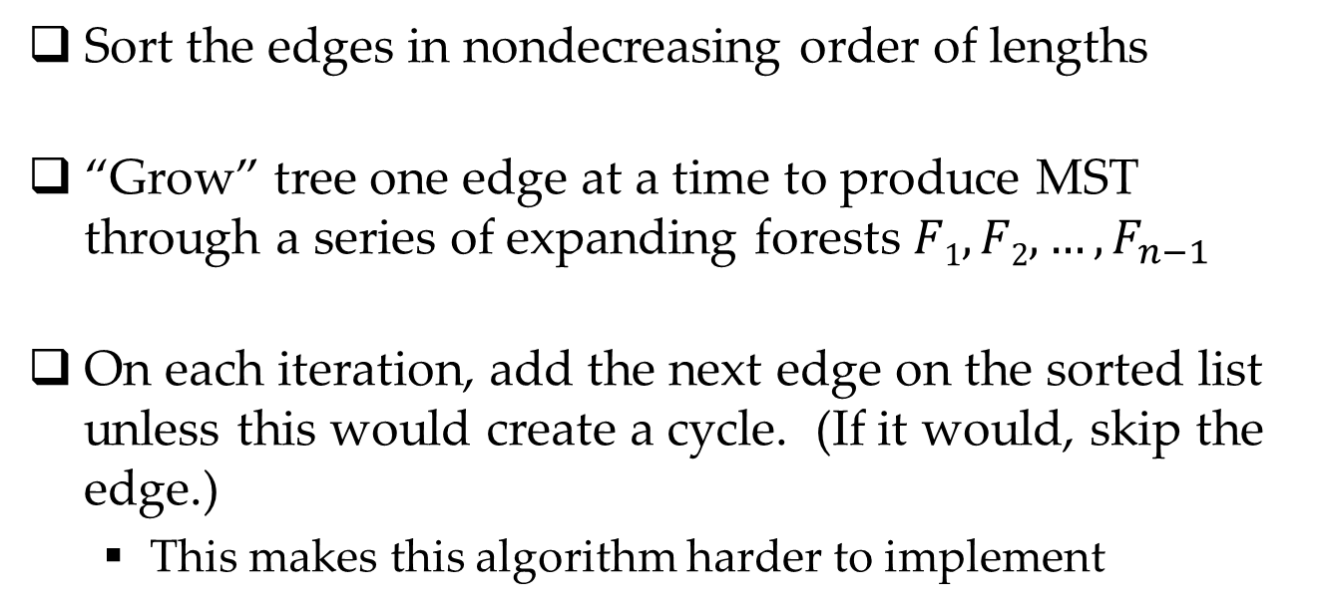
Another greedy algorithm for MST: Kruskal’s
Sort the edges in nondecreasing order of lengths
“Grow” tree one edge at a time to produce MST through a series of expanding forests $F1, F2, …, F_{n−1}$
On each iteration, add the next edge on the sorted list unless this would create a cycle. (If it would, skip the edge.)
This makes this algorithm harder to implement

Slide 56
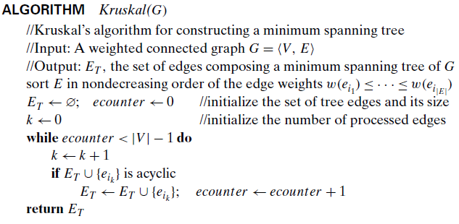
KRUSKAL’s ALGORITHM

Slide 57
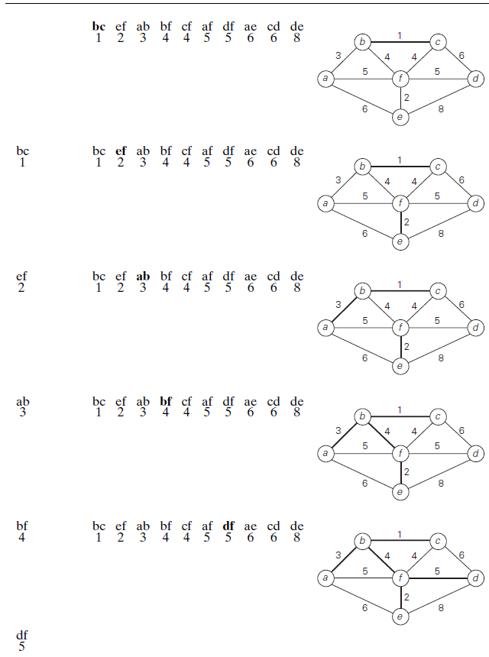
Example

Slide 58
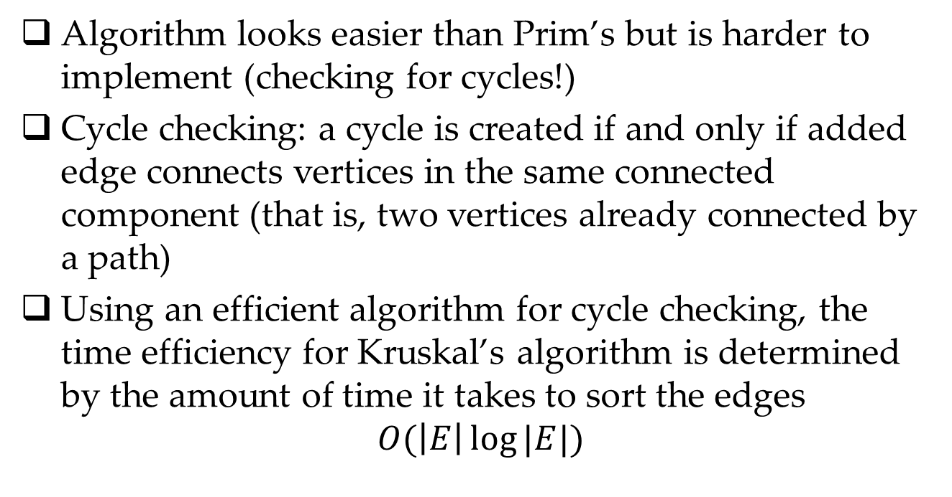
Notes about Kruskal’s algorithm
Algorithm looks easier than Prim’s but is harder to implement (checking for cycles!)
Cycle checking: a cycle is created if and only if added edge connects vertices in the same connected component (that is, two vertices already connected by a path)
Using an efficient algorithm for cycle checking, the time efficiency for Kruskal’s algorithm is determined by the amount of time it takes to sort the edges
$$O(\left|E\right|\log{|E|)}$$
Notes:
Union-find algorithms – see section 9.2

Slide 59
Minimum spanning tree vs. Steiner tree
1
a
c
a
c
1
1
vs
b
d
b
d
1

Slide 60
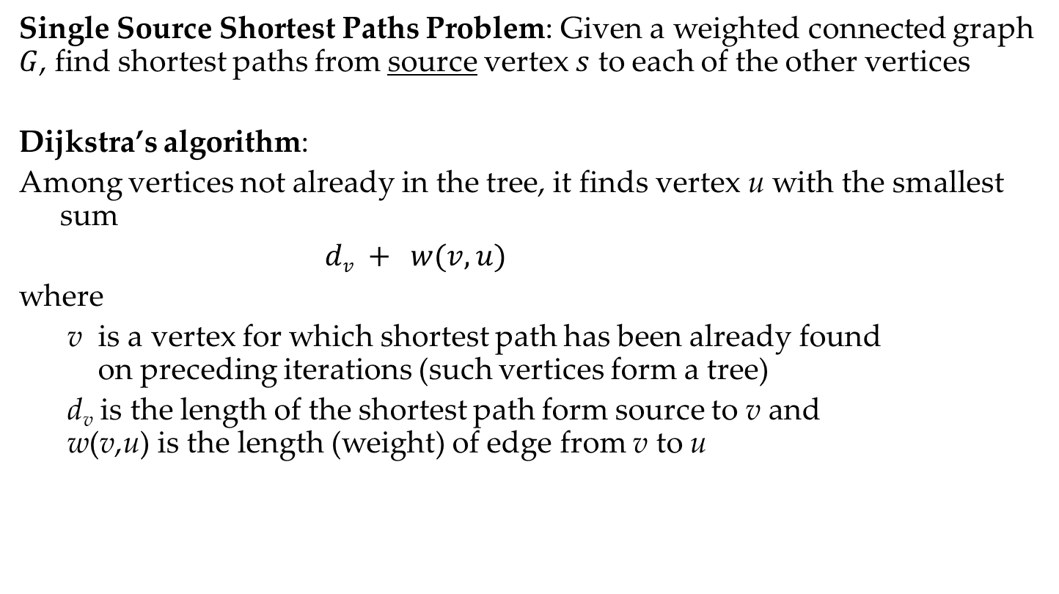
Shortest paths – Dijkstra’s algorithm
Single Source Shortest Paths Problem: Given a weighted connected graph $G$, find shortest paths from source vertex $s$ to each of the other vertices
Dijkstra’s algorithm:
Among vertices not already in the tree, it finds vertex u with the smallest sum
$dv + w(v,u)$
where
v is a vertex for which shortest path has been already found on preceding iterations (such vertices form a tree)
d_{v} is the length of the shortest path form source to v and w(v,u) is the length (weight) of edge from v to u

Slide 61
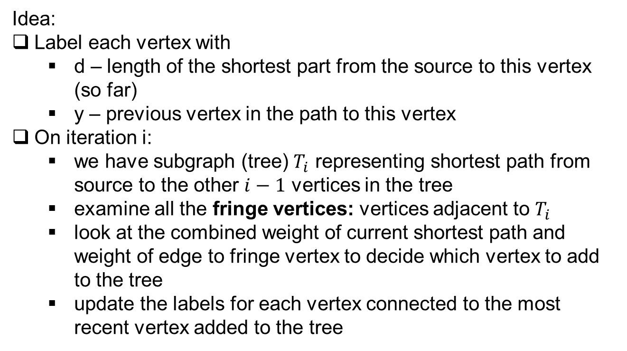
Dijkstra’s algorithm
Idea:
Label each vertex with
d – length of the shortest part from the source to this vertex (so far)
y – previous vertex in the path to this vertex
On iteration i:
we have subgraph (tree) $T_{i}$ representing shortest path from source to the other $i−1$ vertices in the tree
examine all the fringe vertices: vertices adjacent to $T_{i}$
look at the combined weight of current shortest path and weight of edge to fringe vertex to decide which vertex to add to the tree
update the labels for each vertex connected to the most recent vertex added to the tree

Slide 62
Example
Tree vertices Remaining vertices
a(-,0) b(a,3) c(-,∞) d(a,7) e(-,∞)
b
4
c
3
6
7
2
5
4
a
d
d
e
4
b
c
3
2
6
b(a,3) c(b,3+4) d(b,3+2) e(-,∞)
5
a
7
d
4
e
b
4
c
3
6
d(b,5) c(b,7) e(d,5+4)
2
5
a
7
d
4
e
b
4
c
3
6
c(b,7) e(d,9)
2
5
a
7
d
4
e
4
b
c
e(d,9)
3
6
2
5
a
7
d
4
e
Notes:
a is the source
Dijkstra’s algorithm does not necessarily produce the MST

Slide 63
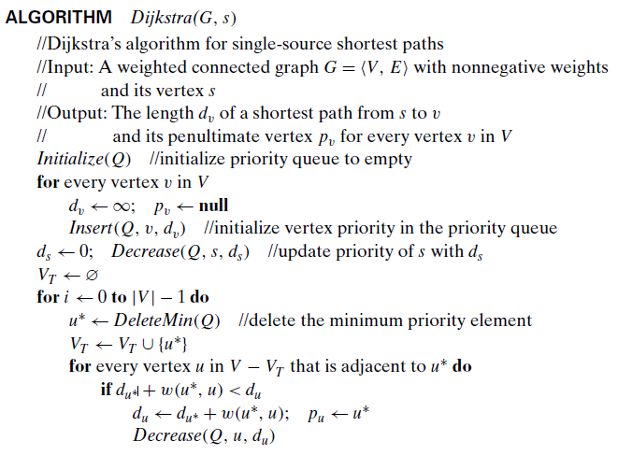
Dijkstra’s algorithm
Notes:
Decrease – means decrease the priority in the queue

Slide 64
Notes on Dijkstra’s algorithm
Doesn’t work for graphs with negative weights
Applicable to both undirected and directed graphs
Efficiency
O(|V|²) for graphs represented by weight matrix and array implementation of priority queue
O(|E|log|V|) for graphs represented by adj. lists and min-heap implementation of priority queue

